Slide 1

“Investigating the Parallels between using a RAT-Style Software for Malicious purposes and virtuous intent”
By Daniel Broomhead
27016005

Slide 2

What is a Rat?
Remote Administration Tool:
Virtuous
Productive
Benevolent
Benignant
Remote Access Trojan:
Promiscuous
Malicious
Deceitful
Surreptitious
At The Heart of it, they are the same ideology and technology.

Slide 3
How are RATs used?
Remote Desktops
Administration
Computers
Remote access software
Usually part of a bigger system
Delivering a payload

Slide 4

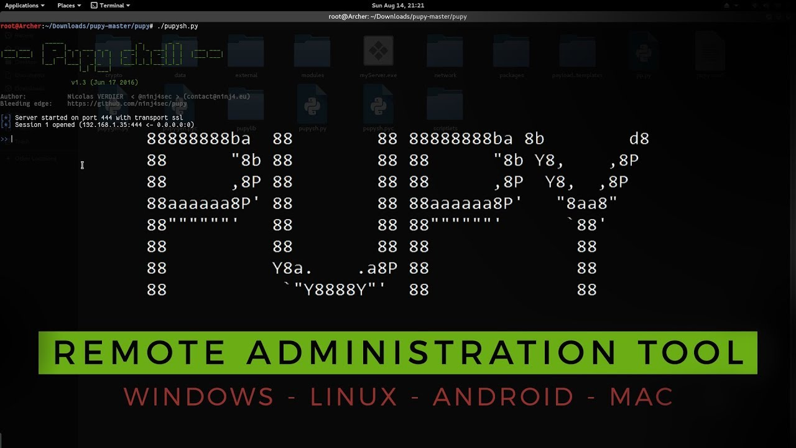

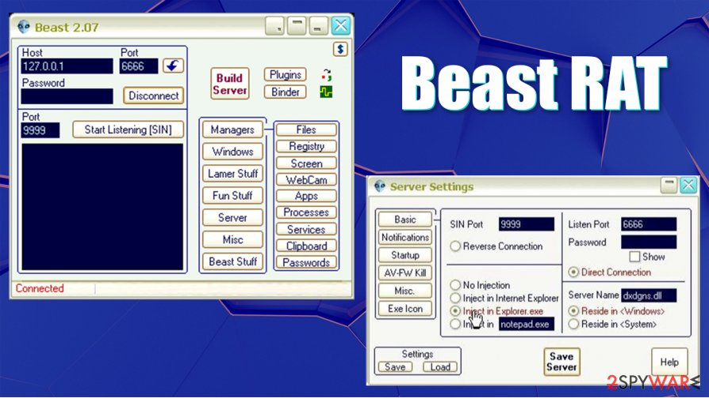
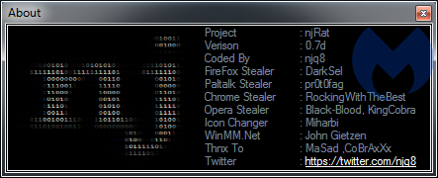
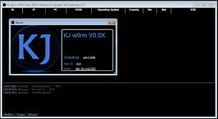
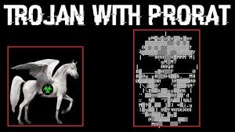

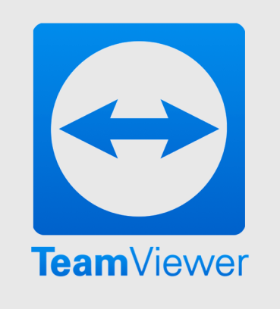
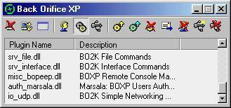
Examples:
Notes:
Beast = Delphi
PuPy – Crossplatform Python
NJ/ KJ JRAT - Java

Slide 5
General Considerations for Rats:
Language:
Methodology:
System:

Slide 6
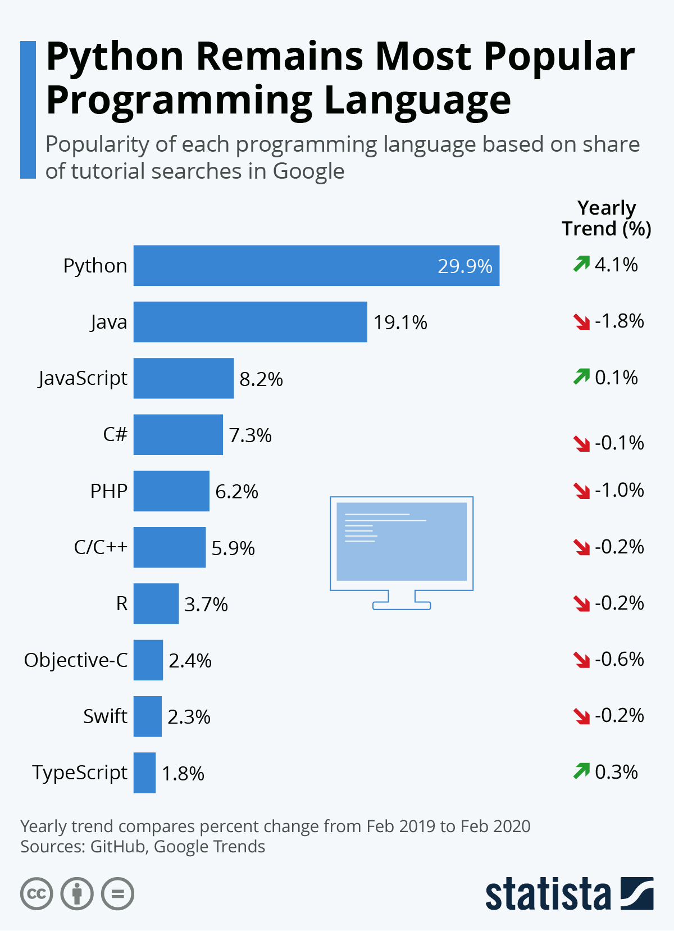
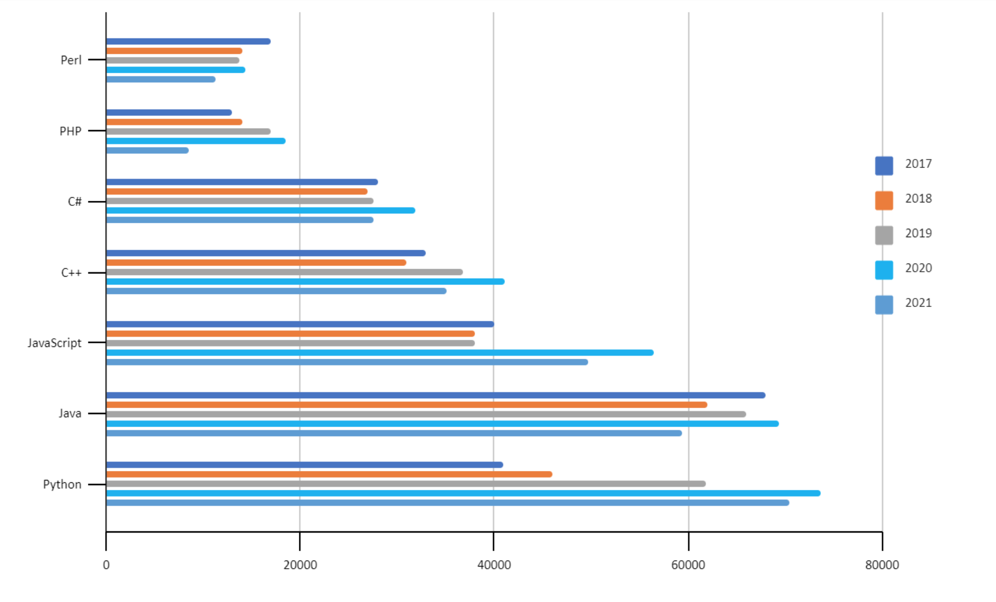
My Rat: The Crucial Decisions
Language Chosen: Python (3)
Python 2 → Deprecated
Python 3 → Gaining popularity faster than ever
Confident in this language
CrossPlatform
https://www.statista.com/chart/21017/most-popular-programming-languages/
https://www.codingdojo.com/blog/top-7-programming-languages
TCP – Socket programming

Slide 7
Current Functionality:
Send a console message.
Shut down remotely.
Copy and retrieve files, and folders.
(non-interactive) Reverse Shell.
Change current working directory on remote device.
Disconnect

Slide 8

Future Functionality & Ideas:
*These features are ideas and not guaranteed to be added*
Send a file
Run a file or script
Take a Screenshot
Key Logger (including start/stop commands)
Get Clipboard Contents
Retrieve keylogger files
Lock Pc
Possible Linux functionality
Upload file
*N.B. Some of these features will only be implemented to work on a Pc running windows 10*

Slide 9
Future Functionality & Ideas:
Graphical user interface : either fully interactive or a graphical design made in console using ASCII art.
Time out feature: Session terminates after extended period.
Acknowledge/Accept Connection: Both parties must acknowledge and accept the connection.
This has been partially implemented but can be improved.
Client can terminate at any point.

Slide 10
How it Works:
Brief demo of code:

Slide 11
What needs to be discussed:
The problem being solved.
The method used.
Results obtained so far.
Introduction, methodology, implementation, results
Background, Objectives, Algorithm, Scalability, applications

Slide 12
Who am i?
Daniel Broomhead
27016005
BCS Berkshire Student Chapter President
BCS Open Source Specialist Group – Young Representative

Slide 13

Glossary & Terms:

